Slide 1

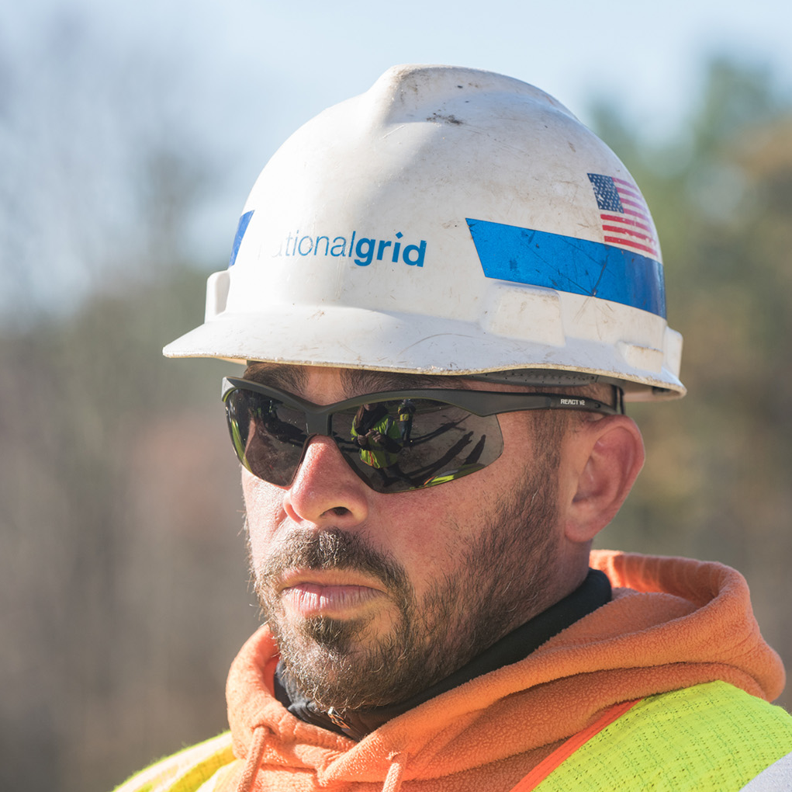
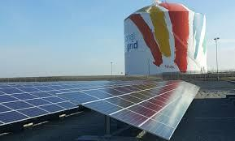
Distributed Generation Interconnection
NY-PAUSE Essential Construction

Slide 2
Distributed Generation Interconnection
NY Joint Utility Essential Construction
Utility | JU DG Work during NY-PAUSE as of 4/9/2020
 | Studies | Site Visits | Field Construction (Simple) | Field Construction (Complex D-Line) | Field Construction (Complex Substation) | Witness Test
National Grid | No Change | To be done virtually if possible; with social distancing if in person | Continuing, with social distancing, for all projects with pre 9/1 PTO date | Continuing, with social distancing, for all projects with pre 9/1 PTO date | No Change | To be done virtually if possible; with social distancing if in person
Central Hudson | No Change | Continuing, with social distancing | Continuing, with social distancing, for all projects with pre 9/1 PTO date. No indoor meter changeouts | Continuing, with social distancing, for all projects with pre 9/1 PTO date | Continuing, with social distancing | Continuing, with social distancing
O&R | No Change | To be done virtually if possible; with social distancing if in person | Continuing, with social distancing, for all projects with pre 9/1 PTO date | Continuing, with social distancing, for all projects with pre 9/1 PTO date | Continuing, with social distancing, for all projects with pre 9/1 PTO date | To be done virtually if possible; with social distancing if in person
RG&E | No Change | Continuing, with social distancing | Continuing, with social distancing. No indoor meter changeouts | Continuing, with social distancing | Continuing, with social distancing | Continuing, with social distancing

Slide 3
Distributed Generation Interconnection
NY Joint Utility Essential Construction
Utility | JU DG Work during NY-PAUSE as of 4/9/2020
 | Studies | Site Visits | Field Construction (Simple) | Field Construction (Complex D-Line) | Field Construction (Complex Substation) | Witness Test
NYSEG | No Change | Continuing, with social distancing | Continuing, with social distancing. No indoor meter changeouts | Continuing, with social distancing | Continuing, with social distancing | Continuing, with social distancing
ConEd | No Change | For areas where meters and equipment are located indoors, inspections and verification tests will be performed using virtual technology i.e. web conferencing services. In the event virtual technology is attempted but not feasible to complete the test, self-verification test may be approved for submission to the Company as an exception. Customers should contact their project manager for more details. | Paused due to COVID-19 | Paused due to COVID-19 | Paused due to COVID-19 | For areas where meters and equipment are located indoors, inspections and verification tests will be performed using virtual technology i.e. web conferencing services. In the event virtual technology is attempted but not feasible to complete the test, self-verification test may be approved for submission to the Company as an exception. Customers should contact their project manager for more details.

